Slide 1
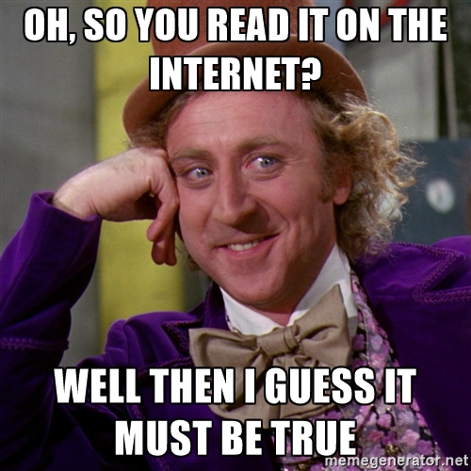
Fighting Fake News
October
2018
Information Literacy is Important!
Misinformation is pollution. Cleaning up the information environment “is everyone’s job,” says Adams, because “other people’s vulnerability to misinformation can affect you –even if you’re savvy enough not to fall for it.” “The Upside of ‘Fake News’: Renewed Calls for Media Literacy” by Peter Adams in Social Education, September 2018 (Vol. 82, #4, p. 232-234)

Slide 2
Data Never Sleeps! We are viewing, using, & creating information at an unprecedented rate. The amount of data in the world is doubling every year.

Slide 3
“Fake News”
A term frequently used, nominated as 2017’s word of the year, and is even now finally being (attempting to be) regulated by social media.
But……what is it?

Slide 4
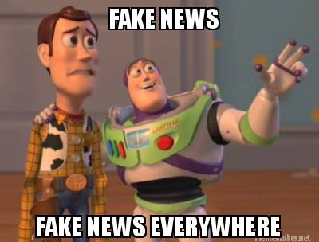
Reflect for a Minute
Take a minute to think about the term “fake news.”
Where have you heard it recently?
Who was saying it?
What was it being used to describe?

Slide 5
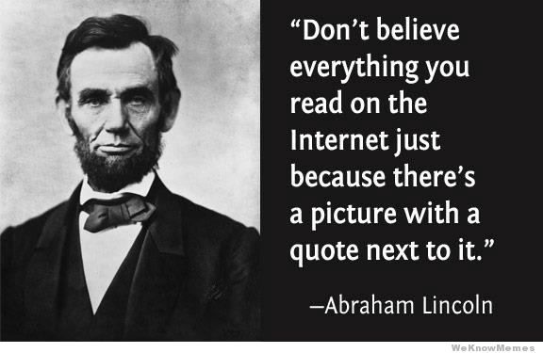
The thing about “fake news”….
The term “FAKE NEWS” is very widely used right now, but it’s largely misused, or at least irresponsibly used. Calling something “fake news” is vague and very over-simplified.
When most people use the term, and how it is used for our purposes, is as a catchall, or umbrella term, under which falls a broad variety of different kinds of false, mis-, and dis-information.

Slide 6
Broad Types of mis/disinformation

Slide 7
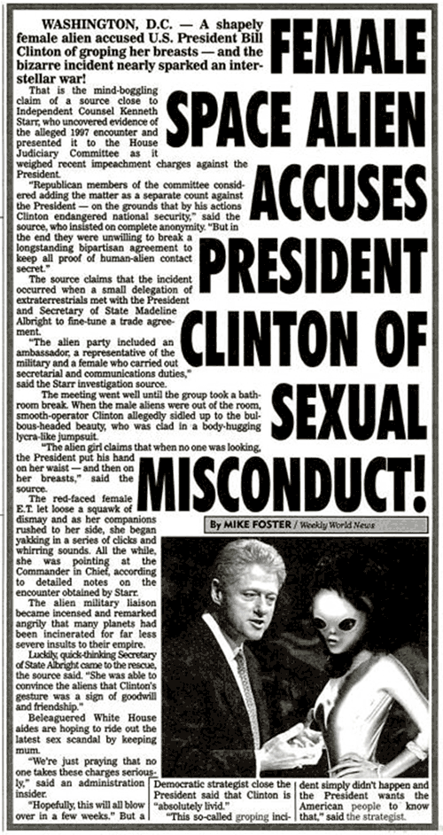
“Fake News” used to look like this
Hoax, pretty obvious, not believed by most people.

Slide 8
But now it looks like this
Fake
Original
Propaganda
Bogus
Fauxtography
Deepfakes

Slide 9
Or this
Clickbait
Fauxtography
Deepfakes
Fake
Original

Slide 10
Sometimes the picture is real, but mislabeled
Misinformation, Mislabeled, Misconstrued,
Out of context

Slide 11
That’s the same boy outside of the “cage”. This was at a protest against immigration policies this year.

Slide 12
Sometimes its Misconstrued
Misinformation, Mislabeled, Misconstrued, Sensational (and false) headlines

Slide 13
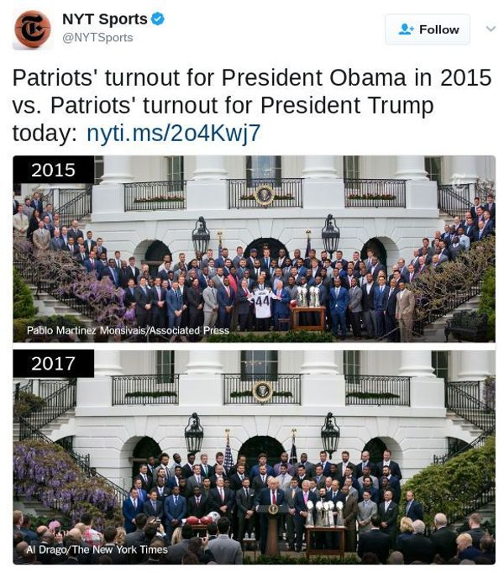

Slide 14
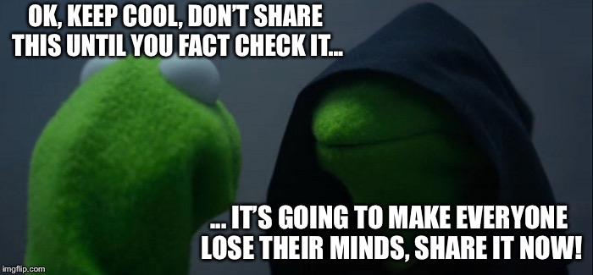
Why is “Fake News” so Problematic?
There are two competing forces within each of us:
Good Kermit, and Evil Kermit……

Slide 15
Educational Leadership November 2017 | Volume 75 | Number 3 The Real Problem with Fake News Erik Palmer
…educators have responded to one of the alarms raised by fake news: the relatively easy problem of how to teach students to find the fakes. We have, however, largely ignored the more important and more difficult problem caused by fake news: how to limit skepticism of the media. For every person fooled by a fake story, there may be many more whose trust in the media in general is diminished. Discounting all news means discounting true news, too. And overwhelmingly, most news is true.

Slide 16
Some causes of the problem….
Viral Nature of the Internet
Algorithms - Filter Bubbles
Psychological - Confirmation Bias
Technology makes creating fakes SO easy
Time consuming to fact check
Internet encourages culture of impatience/instant gratification
Even major news providers sometimes accidentally share “fake news”
Like-farming & monetization
Internet = all about the clicks (= money/power). Designed to deliver personalized info since you are more likely to click that. Emotionally heightened, controversial, polarizing = $$$

Slide 17
Only see what you want to…Filter bubbles
Video on Filter Bubbles
https://www.dw.com/en/pre-programmed-how-to-burst-filter-bubbles/av-44073566
We’re going to need to burst your bubble.
Pre-programmed: How to burst filter bubbles
Algorithms integrated into social networks and search engines glean highly specific information about a user's preferences. And suddenly, incompatible views disappear from that user’s timeline. That’s a filter bubble.

Slide 18
What can you do about “fake news”?

Slide 19
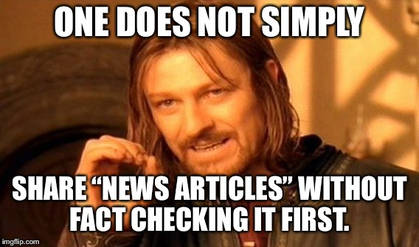
What can you do about it?

Slide 20
Mike Caulfield, Director of Blended and Networked Learning, Washington State University
“When you feel strong emotion – happiness, anger, pride, vindication – and that emotion pushes you to share a ‘fact’ with others, STOP.”
https://webliteracy.pressbooks.com/front-matter/web-strategies-for-student-fact-checkers/

Slide 21
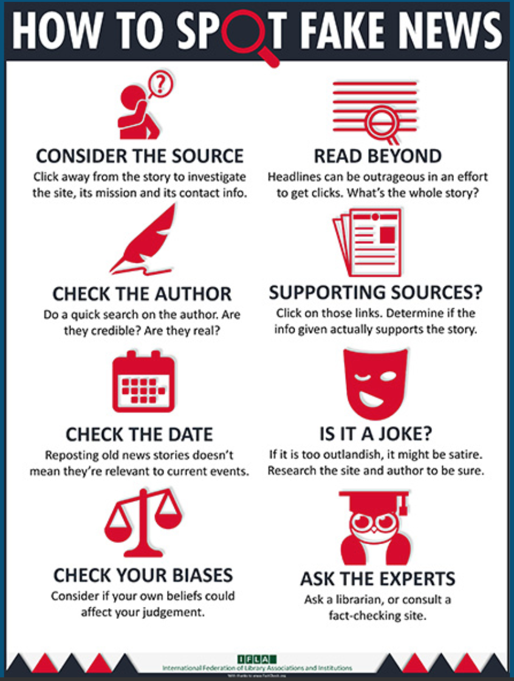
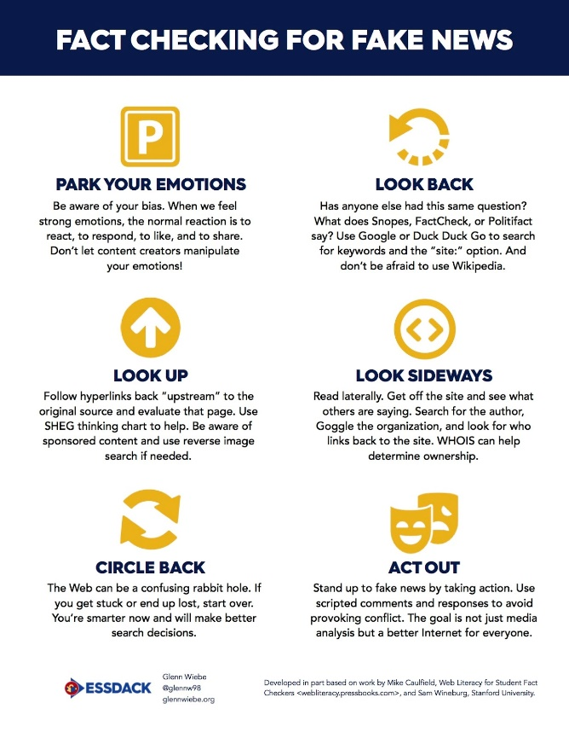

Slide 22
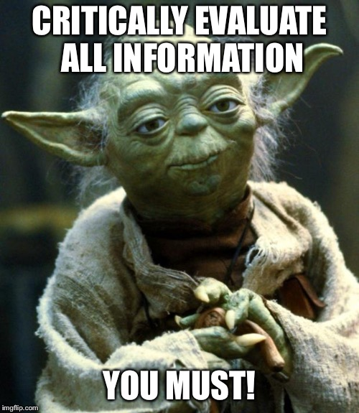
As a teacher, what can I do?
Get ready to get your hands dirty!
Prepare to learn with and from your students
Be an investigator
encourage students to question … well, everything!
Model best practices
Incorporate news, media, and info literacy skills in your own searching and daily life.
REQUIRE students to evaluate sources… always!
Always require sources/works cited/annotated bibliographies
Incorporate these skills into any and every lesson you can.
News, media, and info literacies are critical for our students to be future ready.
Collaborate with your librarian!
Excellent, short article for implementing in your classroom! https://www.edutopia.org/article/guiding-students-be-open-new-ideas

Slide 23
Even more resources, tips, techniques, etc

Slide 24
Fact Checking Resources
AllSides. While not a fact-checking site, AllSides curates stories from right, center and left-leaning media so that readers can easily compare how bias influences reporting.
Fact Check. This nonpartisan, nonprofit monitors the factual accuracy of what is said by U.S. political players, including politicians, TV ads, debates, interviews and news releases.
Media Matters. This nonprofit and self-described liberal-leaning research center monitors and corrects conservative misinformation in the media.
NewsBusters. A project of the conservative Media Research Center, NewsBusters is focused on “documenting, exposing and neutralizing liberal media bias.”
Open Secrets. Run by the Center for Responsive Politics tracks how much and where candidates get their money.
Politifact. This Pulitzer Prize winning website rates the accuracy of claims by elected officials. Features the Truth-O-Meter that rates statements as “True,” “Mostly True,” “Half True,” “False,” and “Pants on Fire.”
ProPublica. Has won several Pulitzer Prizes. ProPublica produces investigative journalism in the public interest.
Snopes. Often the first to set facts straight on wild fake news claims.
The Sunlight Foundation. Uses public policy data-based journalism to make politics more transparent/accountable.
Washington Post Fact Checker. Although WP has a left-center bias, its checks are excellent and sourced. Bias because they fact check conservative claims more than liberal ones.
Who Is Find out who is behind a particular domain or IP address. Great for verifying who is responsible for a website.
Google Reverse Image Search An excellent tool for verifying the origins of a photo.
B.S. Detector A browser extension that alerts users to unreliable news sources.

Slide 25
Check your “facts”!
Fact Checking Resources
AllSides. While not a fact-checking site, AllSides curates stories from right, center and left-leaning media so that readers can easily compare how bias influences reporting.
Fact Check. This nonpartisan, nonprofit monitors the factual accuracy of what is said by U.S. political players, including politicians, TV ads, debates, interviews and news releases.
Media Matters. This nonprofit and self-described liberal-leaning research center monitors and corrects conservative misinformation in the media.
NewsBusters. A project of the conservative Media Research Center, NewsBusters is focused on “documenting, exposing and neutralizing liberal media bias.”
Open Secrets. Run by the Center for Responsive Politics tracks how much and where candidates get their money.
Politifact. This Pulitzer Prize winning website rates the accuracy of claims by elected officials. Features the Truth-O-Meter that rates statements as “True,” “Mostly True,” “Half True,” “False,” and “Pants on Fire.”
ProPublica. Has won several Pulitzer Prizes. ProPublica produces investigative journalism in the public interest.
Snopes. Often the first to set facts straight on wild fake news claims.
The Sunlight Foundation. Uses public policy data-based journalism to make politics more transparent/accountable.
Washington Post Fact Checker. Although WP has a left-center bias, its checks are excellent and sourced. Bias because they fact check conservative claims more than liberal ones.
Who Is Find out who is behind a particular domain or IP address. Great for verifying who is responsible for a website.
Google Reverse Image Search An excellent tool for verifying the origins of a photo.
B.S. Detector A browser extension that alerts users to unreliable news sources.

Slide 26
News, Media, & Information literacy resources
Common Sense Media – (educator resources)
That’s nonsense.com – (fact checking)
Media Bias Factcheck – (check bias)
Listing of known “fake news,” clickbait, hoax, etc websites
https://fourmoves.blog/ - (educator resources)
This site contains prompts for lessons that are meant to be facilitated in a face to face sessions.
NewseumEd
Free learning tools on media literacy and our First Amendment freedoms
Tools to use
Rate my source tool
Newsguard (browser extension for chrome)
Fake News Tools from OSoMe
Surfsafe – (browser extension) for photos
Blue Feed Red Feed from Wall Street Journal
See Liberal Facebook and Conservative Facebook, Side by Side
FlipFeed – step into someone else’s twitterverse to see things from the other side.
Read Across the Aisle (app) – “a fitbit for your filter bubble”
Politecho (chrome extension) – keep an eye on, and analyze, your facebook filter bubble.
Twitter Accounts to Follow
@MediaLiteracyEd - NAMLE
@NewsLit Project - News Literacy Project
@CommonSenseEd - Common Sense Media
@NewsHourExtra - PBS NewsHour Extra
@NCTE
Resources compiled by UMASS Amherst
Great article from Axios on future of fake news
Lesson plan resources from Easybib

Slide 27
Part vi real world consequences

Slide 28
Real World Consequences

Slide 29
When “fake news” goes viral

Slide 30
And Recently on Facebook…
Beware the viral Facebook hoax that’s tricking people into thinking their account was hacked!
It reads something like this:
“Hi....I actually got another friend request from you which I ignored so you may want to check your account. Hold your finger on the message until the forward button appears...then hit forward and all the people you want to forward too....I had to do the people individually. PLEASE DO NOT ACCEPT A NEW friendship FROM ME AT THIS TIME.”
If truly concerned though, the easiest thing to do is change your social media password, which experts counsel to do at least once every three months.

Slide 31
Officials say it is a total hoax.
Your account isn’t hacked, there are no duplicate friend requests and you did not receive a request from the person you’re forwarding it to.
The office says to simply ignore the message. There are no bugs or hacks linked to it, it is just an annoying chain message.

Slide 32
Consider this

Slide 33
THANK YOU!
Reni McManus

Slide 34
Works Cited

Slide 35
Credits & Works cited
Slide 2
Lewis, Lori, and Chadd Callahan. "2018 This is What Happens in an Internet Minute." Visual Capitalist, 14 May 2018, www.visualcapitalist.com/internet-minute-2018/.
Accessed 2 Sept. 2018. Infographic.
Slide 4
Fake news newsstand graphic. Tumblr, 68.media.tumblr.com/d7b795eb92f6eb2dcf22b8f27663781a/tumblr_oi4gxkkJRh1uao3xco1_1280.png. Accessed 2 Sept. 2018.
Slide 5
"Fake News Fake News Everywhere." Meme Maker, www.mememaker.net/meme/fake-news-fake-news-everywhere/. Accessed 2 Sept. 2018.
Slide 6
Bogan, Kelsey. Willy Wonka meme. Meme Generator, 30 Jun. 2018.
Slide 7
@realDonaldTrump. “The Fake News hates me saying that they are the Enemy of the People only because they know it’s TRUE. I am providing a great service by explaining this to the Americna People. They purposely cause great division & distrust. They can also cause War!.” Twitter, 5 Aug. 2018, 7:38 a.m., twitter.com/realDonaldTrump/status/1026069857589227520
@realDonaldTrump. “So they caught Fake News CNN cold, but what about NBC, CBS & ABC? What about the failing @nytimes & @washingtonpost? They are all Fake News!.” Twitter, 27 Jun. 2017, 8:47 a.m, twitter.com/realDonaldTrump/status/879682547235651584
Slide 9
Bogan, Kelsey. Not Sure meme. ImgFlip, 30 Jun. 2018.
Slide 11
“Don’t Believe Everything You Read." We Know Memes, http://weknowmemes.com/2012/07/dont-believe-everything-you-read-on-the-internet/. 20 July 2012.
Accessed 2 Sept. 2018.
Slide 12
Wardle, Claire. "7 Types of Mis- and Disinformation." Medium, First Draft, 16 Feb. 2017, medium.com/1st-draft/fake-news-its-complicated-d0f773766c79. Accessed 2 Sept. 2018. Infographic.

Slide 36
Credits & Works cited
Slide 14
Hillary Clinton Adopts Alien Baby. Mother Jones, www.motherjones.com/media/2015/04/weekly-world-news-clintons-aliens/. Accessed 2 Sept. 2018.
Female Space Alien Accuses President Clinton of Sexual Misconduct. Mother Jones, www.motherjones.com/media/2015/04/weekly-world-news-clintons-aliens/. Accessed 2 Sept. 2018.
Slide 15
Emma Gonzales Hoax. Media Matters for America, www.mediamatters.org/blog/2018/03/26/Here-are-the-hoaxes-surrounding-the-Parkland-shooting-and-the-Stoneman- Douglas-students/219743. Accessed 2 Sept. 2018.
Slide 16
KKK Rally. Snopes, www.snopes.com/news/2017/12/29/2017-the-year-in-fauxtography/. Accessed 2 Sept. 2018.
Slide 17
Putin hoax picture. Business Insider, www.businessinsider.com/fake-viral-photo-trump-putin-g20-2017-7. Accessed 2 Sept. 2018.
Slide 18
Child in cage. Snopes, www.snopes.com/fact-check/toddler-cage-photo/. Accessed 2 Sept. 2018.
Slide 19
Child out of cage. Snopes, www.snopes.com/fact-check/toddler-cage-photo/. Accessed 2 Sept. 2018.
Slide 20
Patriots turnout for Presidents. 19 Apr. 2017. Snopes, www.snopes.com/news/2017/12/29/2017-the-year-in-fauxtography/. Accessed 2 Sept. 2018.
Slide 21
Comparable White House photos. Snopes, www.snopes.com/news/2017/12/29/2017-the-year-in-fauxtography/. Accessed 2 Sept. 2018.
Slide 22
Poland First Lady Snubs Trump Real. Snopes, www.snopes.com/fact-check/polish-first-lady-trump-handshake/. Accessed 2 Sept. 2018.
Slide 24
Bogan, Kelsey. Evil Kermit meme. ImgFlip, 30 Jun. 2018.

Slide 37
Credits & Works cited
Slide 25
"Why Do So Many People Share and Believe Fake News?" YouTube, uploaded by SciShow Psy, 16 Apr. 2018, www.youtube.com/watch?v=MYT8lWfKcCA. Accessed 2 Sept. 2018.
Slide 26
"How can you burst your filter bubble? - BBC Trending." YouTube, uploaded by BBC Trending, 3 June 2017, www.youtube.com/watch?v=mh1dLvGe06Y. Accessed 2 Sept. 2018.
"Pre-programmed: How to burst filter bubbles." Deutsche Welle, 6 May 2018, p.dw.com/p/2yvXy. Accessed 2 Sept. 2018.
Slide 27
Bogan, Kelsey. Nailed it Baby meme. ImgFlip, 30 Jun. 2018.
Slide 28
Bogan, Kelsey. Thoughtful Dinosaur meme. ImgFlip, 30 Jun. 2018.
Slide 30
Bogan, Kelsey. One Does Not Simply meme. ImgFlip, 30 Jun. 2018.
Slide 31
Web Literacy for Student Fact Checkers. Pressbooks, webliteracy.pressbooks.com/front-matter/web-strategies-for-student-fact-checkers/. Accessed 2 Sept. 2018.
Slide 32
Weibe, Glenn. "Fact Checking for Fake News." History Tech, 15 June 2017, historytech.wordpress.com/2017/06/15/tip-of-the-week-6-strategies-your-students-can-use-to- combat-fake-news/. Accessed 2 Sept. 2018. Infographic.
"How to Spot Fake News." IFLA, 2018, www.ifla.org/publications/node/11174. Accessed 2 Sept. 2018. Infographic.
Slide 33
"10 Good Tips to Spot Fake News." Educational Technology and Mobile Learning, 15 Apr. 20`7, www.educatorstechnology.com/2017/04/10-good-tips-to-spot-fake-news.html. Accessed 2 Sept. 2018. Infographic.

Slide 38
Credits & Works cited
Slide 34
Some portions of this slide inspired by:
Burns, Robin, and Sandra Reilly. "Information literacy: the fight against fake news." Pennsylvania School Library Association Conference, 5 May 2018, Hershey Convention Center. Lecture.
Slide 39
Facebook post screencast. Information Literacy Presentation, docs.google.com/presentation/d/1-q-_f2Dzi-cAOVlsy6hysqf3Ge5I-8OXZW4_BvtJv74/mobilepresent?slide=id.p.
Slide 40
"Top 5 Fake Election Stories by Facebook Engagement." Engadget, 7 Nov. 2017, www.engadget.com/2016/11/17/facebook-fake-news-activity-spiked-near-election-day/. Accessed 2 Sept. 2018. Infographic.
Slide 41
Comet. Wikipedia, en.wikipedia.org/wiki/Pizzagate_conspiracy_theory. Accessed 2 Sept. 2018.
Slideshow courtesy of Great Valley High School https://www.gvsd.org/Page/16472

Slide 39
Tools and Resources to Check Sources
Rate my source tool
Newsguard (browser extension for chrome)
Common Sense Media – (educator resources)
That’s nonsense.com – (fact checking)
Media Bias Factcheck – (check bias)
Listing of known “fake news,” clickbait, hoax, etc websites
https://fourmoves.blog/ - (educator resources)
–This site contains prompts for lessons that are meant to be facilitated in a face to face sessions.
Fake News Tools from OSoMe
NewseumEd - Free learning tools on media literacy and our First Amendment freedoms
Resources compiled by UMASS Amherst
Surfsafe – (browser extension) for photos
Great article from Axios on future of fake news
Lesson plan resources from Easybib
Blue Feed Red Feed from Wall Street Journal = See Liberal Facebook and Conservative Facebook, Side by Side
FlipFeed – step into someone else’s twitterverse to see things from the other side.
Read Across the Aisle (app) – “a fitbit for your filter bubble”
Politecho (chrome extension) – keep an eye on, and analyze, your facebook filter bubble.

